Slide 1
Automatic Uniaxial Tensiometer
Farid Barak, Nour El Banna, Kihyun Lee, Alex Reyes
Team #4 Test Yo Limit!

Slide 2
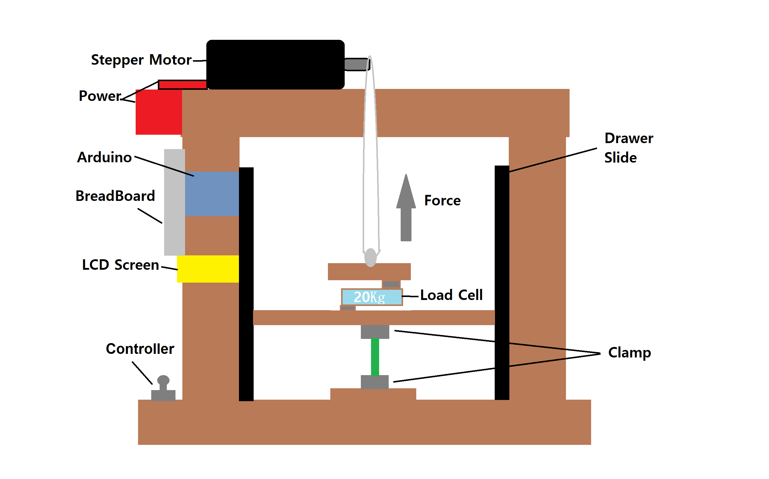
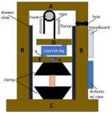
Physical Model

Slide 3
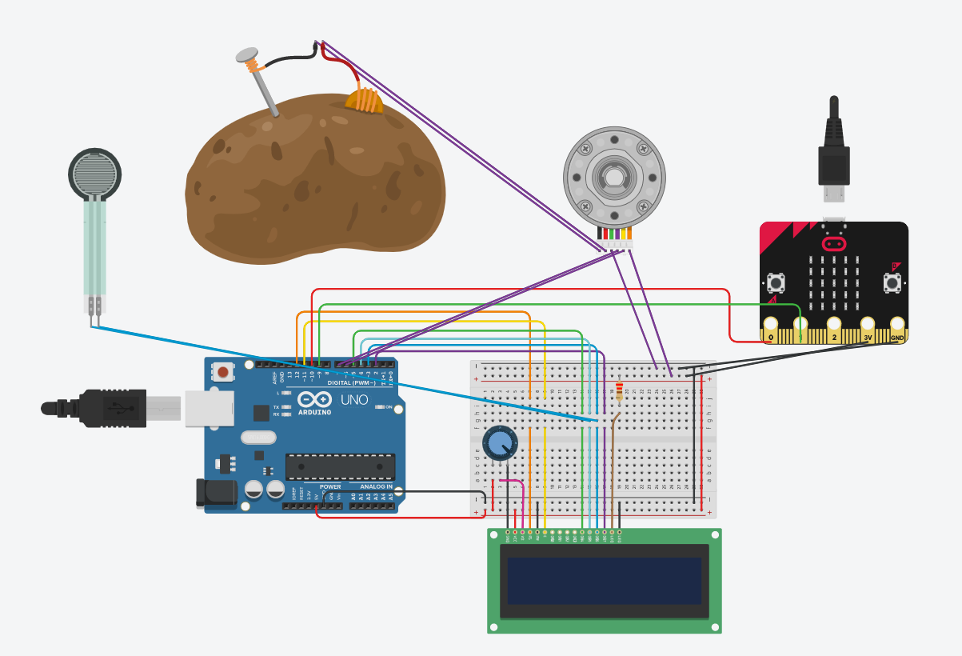
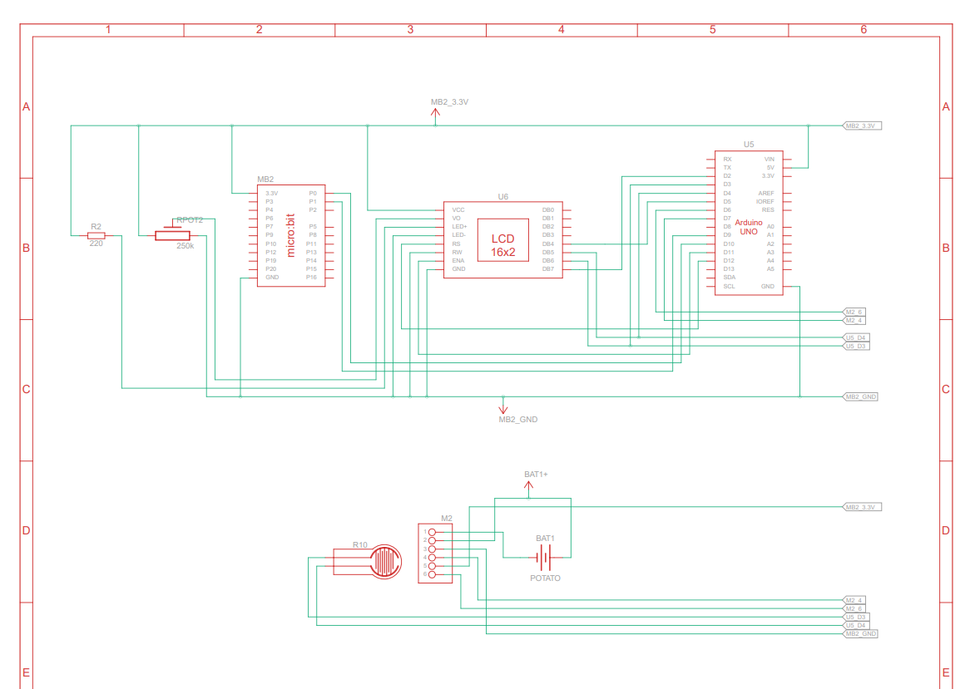

Slide 4
Key Items We Focused on
Because this system will be used by non-tech savvy students, we decided a fully automated system would be better than a manual crank or pull
Ensure reliability by eliminating unneeded components (distance/acoustic sensor)
Simplifying the system as much as possible
Components can easily be accessible/replaced in case of failure
Meeting the required budget
Ultimately make it a stand-alone

Slide 5
System Components & Budget​
Part​ | Purpose​ | Cost​
Stepper Motor​ | Automates straining of material, measures Distance​ | $65
Metal Clamps​ | To hold material​ | $19​
Load Cell 20kg HX711​ | Measures Force/Stress​ | $10​
Kevlar Fishing Line ​ | Ropes to pull clamps​ | $8​
16x2 LCD Screen​ | Displaying the results​ | $16​
TOTAL​ |  | $118

Slide 6
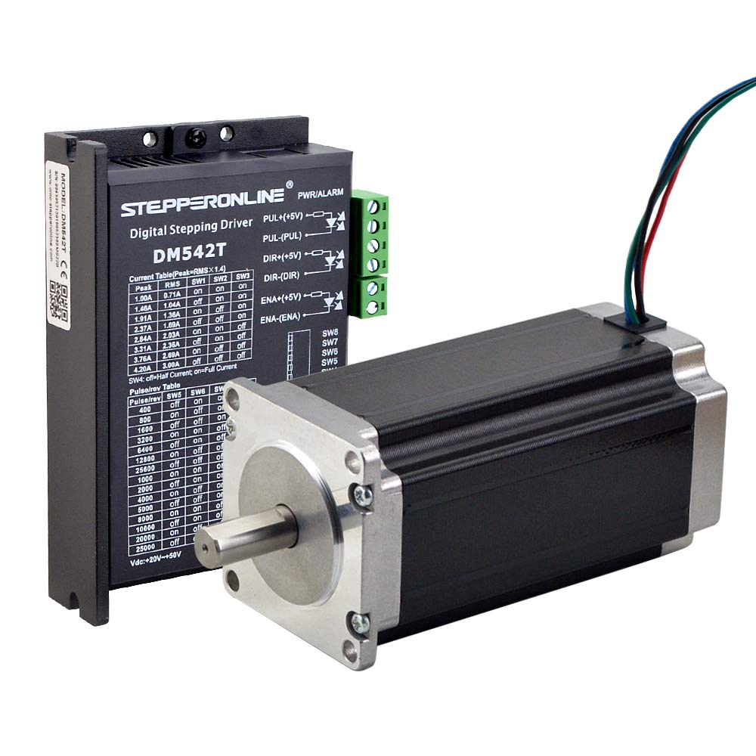
High precision stepper motor used
A NEMA 23 size motor was used
Stepper motors allow micro-stepping, ensuring each step/"pulse" moves a certain controlled distance
Our setup allows the motor to increment ~0.9 mm for every pulse given
System calibrates automatically on each test

Slide 7
Advantages and Disadvantages
Advantages
Precise and accurate stress/strain curve
Simple GUI with joystick navigation
Reliable with minimum maintenance required
Meets budget of $150
Disadvantages
Slightly complex, issues cannot easily be troubleshooted by average user
Requires 110V AC power source (an outlet)
Data extraction can be simplified further by an SD card
Alternative software can be used, negating the need for MATLAB
I2C protocol can be used to reduce wiring

Slide 8
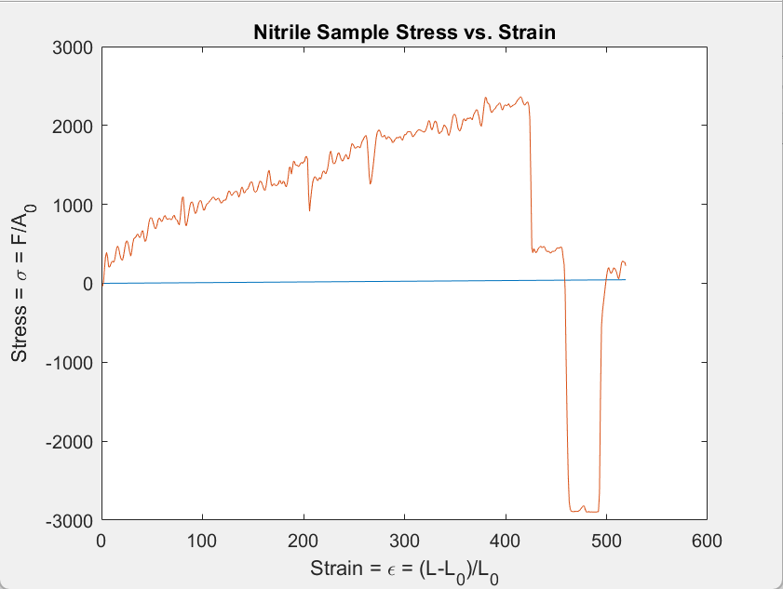
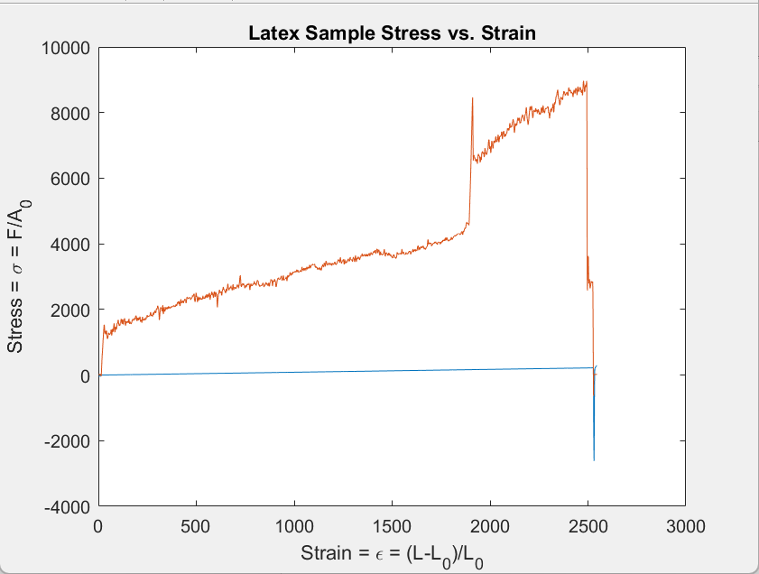
Sample Test Results

Slide 9
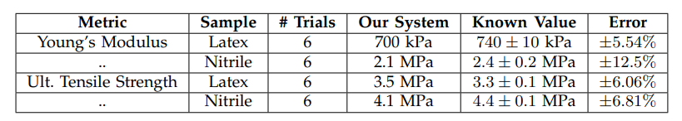
Sample Data Results

Slide 10
Improvements
Stepper motor
Clamps

Slide 11
Thank You!

